Slide 1

Defence Ventures

Slide 2

Defence Ventures
Defence Ventures is an early stage venture capital firm that specialises in defence technology innovation. They have developed a product called ShieldX to act as an advanced and secure software defence solution. The solution primarily focuses on processing data related to network traffic and application activity, therefore they will never intentionally store a user's personal data.
For the Defence Ventures case study, we have used a range of technologies, including a centralised management console, a distributed network of secure Agents, multi-layered security, antivirus solutions, and encryption. The data we have stored in our databases include network traffic and application activity within an organisation's IT infrastructure, such as IP addresses, ports, packet sizes, timestamps, and applciation event logs.
Defence Ventures was chosen for this case study due to its medium risk appetite, which contrasts AstroDev's high risk appetite. Defence systems is also an interesting topic which was another reason for our selection.
Notes:
Maciej

Slide 3
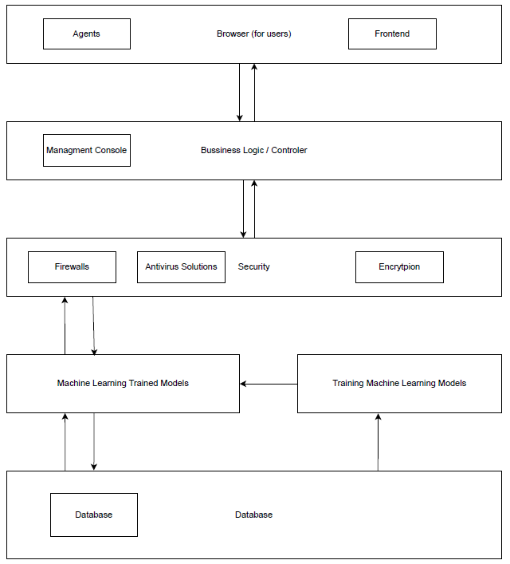
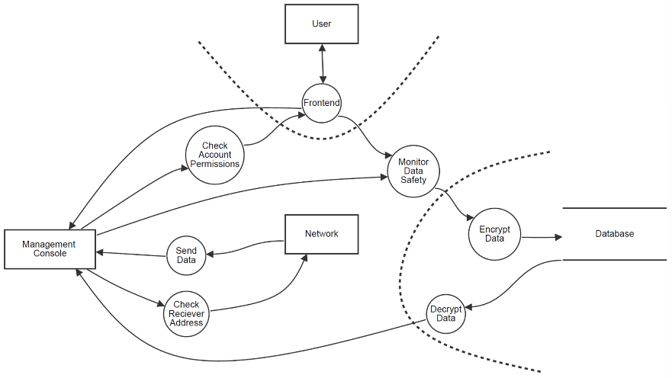
Defence Ventures Threat Model and Architecture
Four Question Model:​
What are we building – ShieldX: A secure defence software that benefits both military and civilian sectors, where it acts as a solution of providing barriers of security for defence organisations' systems.​
What can go wrong – Unknown threats that aren't registered with ShieldX can slip through and cause problems with organisations' systems.​
What are we going to do about it – Regularly record newfound threats to provide solutions and prevent attacks on systems​
Did we do a good job – From identifying our threats and mitigations, we believe we did a good job.
Notes:
Unais

Slide 4
ID | Threat | Type | Likelihood | Impact | Risk Treatment Strategy | Mitigation | Owner | Deadline
T02 | Wrongful Request of Data | Information Disclosure | 3 | 3 | Mitigation | Monitor where the user is requesting data from, if it's not an approved IP cancel the request. Also ensure that it is from an employee's account. | Security Team | On-Going
T03 | Access to too much information | Elevation of Privilege | 2 | 3 | Mitigation | Give user the minimum number of permissions to be able to do their job. | Development Team | Sprint 1
T04 | Account Breach | Spoofing | 4 | 5 | Mitigation | Appropriately authorise the user and introduce integrity checks (such as Hashes and Digital Signatures | Security Team / Development Team | Sprint 2
T05 | Manipulation of Data | Tampering | 3 | 3 | Mitigation | Implement appropriate authorisation measures and introduce integrity checks, such as Hashes. | Development Team | Sprint 1
T06 | DDoS Attack | Denial of Service | 1 | 2 | Mitigation | Network monitoring to ensure packets are from an authorised user | Development Team | Sprint 2
T07 | Repudiation Attack | Repudiation | 2 | 3 | Mitigation | Ensure appropriate authorisation is put in place, check audit logs and timestamps | Security Team | On-going
Notes:
Unais

Slide 5
Defence Ventures Software Development Plan
Security Properties in the Development Lifecycle
Confidentiality – Users will have bare minimum access to ShieldX and sensitive data will be encrypted
Integrity – All important data and logs will have integrity safeguards in place and multi-factor authentication will be put in place for accounts.
Availability – Data packets in networks will be monitored and ShieldX will remove redundancies in its systems to ensure continuity.
Securing the Development Environment
Access Control in Development – Only users with permissions can read or alter source code.
Isolation – Develop ShieldX in isolated environments to prevent unwanted access.
Frequent Audits – Conduct frequent security audits to resolve possible security threats early.
Use of Appropriate Tools for Secure Development
Dynamic Analysis Tools – Incorporate tools such as OWASP ZAP to find security flaws in code.
Dependency Scanners – Check dependencies for vulnerabilities to make sure third-party libraries are safe.
Threat Modelling Tools – Using tools like Thread Dragon, map potential vulnerabilities and control measures. Use the threat model as a guide to mitigate threats.
Secure Development Practices
Secure by Design – Every phases of the software development lifecycle incorporate security needs, such as audit trail tracking and access controls for ShieldX features.
Secure by Default – Default configurations will adhere to the least privilege principle and will only expose necessary functionalities.
Code Reviews and Pair Programming – This will be implemented to detect possible security vulnerabilities early. This procedure will be required for all security-related critical code paths, including encryption and authentication.
5. Security Management
Access Control and Secrets Management – Assign roles according to job duties, ensure private data is safely secured and access tracked, and use short-lived tokens for sessions to prevent overdue access.
Preventing Vulnerabilities – Frequently update ShieldX's dependencies and libraries, educate developers on security risks and safe coding techniques, and make sure ShieldX continues to adhere to security requirements.
Responding to Vulnerabilities – Create an up-to-date response strategy to respond to security incidents, thoroughly log and monitor user activity, and quickly patch vulnerabilities found in ShieldX's system.
Notes:
Maciej

Slide 6
Defence Ventures SAMM Document
The OWASP SAMM score is 23.03/45
This is due to the moderate risk-appetite. Defence Ventures is primarily focusing on maintaining operations and reputation without taking on excessive risks, therefore only taking risks if it benefits business and clients.
We have added in changes to employee training as current employee awareness of cybersecurity needs to be higher to ensure better security practices across the business. Employees should also be able to handle any incorrect data transmissions.
The new implementations will now focus on:
Educating employees in practices related to password management, email security, safe browsing habits, and social engineering tactics.
Educating employees in being able to handle certain data to ensure that no personal data of customers or staff is intentionally stored.
Notes:
Unais

Slide 7

Maciej's Requirements
Title | Asset | Threat | Narrative | Work Required | Verification Criteria
(MFA) for User Access | User accounts | Spoofing | Attackers may pose as users in order to obtain unapproved access | All user logins should have multi-factor authentication (MFA), with sensitive operations needing a second factor | Check for MFA enforcement and confirm password-only access prohibition
Data Encryption in Transit and at Rest | Sensitive data | Information Disclosure | Data that isn't encrypted can be intercepted | Encrypt data with AES-256 at rest and TLS in transit, secure key management | Verify transmission security using packet inspection and confirm encryption in code reviews
Logging and Audit Trails for Sensitive Actions | System logs | Repudiation | Malicious users might erase logs to hide illegal activity | Keep an eye out for tampering and record any sensitive acts with limited access | Use packet inspection to verify transmission security, and use code reviews to validate encryption

Slide 8
Unais's Requirements
Title | Asset | Threat | Narrative | Work Required | Verification Criteria
User Authorisation for Database Access | Databases | Tampering | An attacker abuses the application to perform unintended updates to a database. | Implement appropriate authorisation measures and introduce integrity checks, such as Hashes and Digital Signatures. | Test the integrity methods using unauthorised accounts to update the database with. Rework the solution accordingly based on results.
Monitor Network Packets to Authorise Users | Network | Denial of Service | Attacker launches a denial of service (DDoS) attack, preventing the network from being used. | Network monitoring to ensure packets are from an authorised user. | Send malicious data packets in a closed network to test the system. Rework the solution based on the effect of the packets. Ensure users sending packets are authorised with the network through checks.
Restrict Privileges from Users to Prevent Unwanted Activity | Defence System | Elevation of Privilege | A user may access more data than they need, allowing them to have too much control over a system. | Give a user the minimum number of permissions to be able to do their job. | Test accounts with different levels of privileges and see which ones can perform certain tasks.

Slide 9
Adam’s Requirements
Title | Asset | Threat | Narrative | Work Required | Verification Criteria
DDOS Attack | Servers | Denial of Service | An attacker can overload the servers causing server crashes leading to downtime. | A WAF system should be implemented blocking unknown IPs making requests to the server. | Test by attempting to access the site with approved and unapproved data to simulate DDOS attacks.
Access to too much information | Databases | Information Disclosure, Elevation of privilege | Staff could gain access to sensitive information leading to potential data leaks. | Minimum access privilege needs to be implemented. Data should only be accessible if it is in the work scope. | Create test accounts to verify that minimum access privilege is ensured
Spear phising attack | User accounts | Spoofing, information disclosure | An attacker could send a target phishing email to an employee leading to their credentials being stolen. | All employees must receive training to spot attacks, they must have 2FA active and regularly change their passwords. | Employees will be targeted for phishing emails; they will have a system to notify password changes and 2FA is on automatically.

Slide 10
Thank you any questions?

